Slide 1

Northwind Traders
Statistical Analysis
Presented by : Sharonda Warner
Notes:
Presented by : Sharonda Warner | October 15, 2019
FlatIron Project 3: Hypothesis Testing

Slide 2
Problem Statement
Analyze Northwind Traders Data
Generate Business Insights
Customer Behavior
Product Discounts
Shipping Company Performance

Slide 3


Business Value
Improve Business Understanding
Understand Market Demand
Increase Revenue

Slide 4
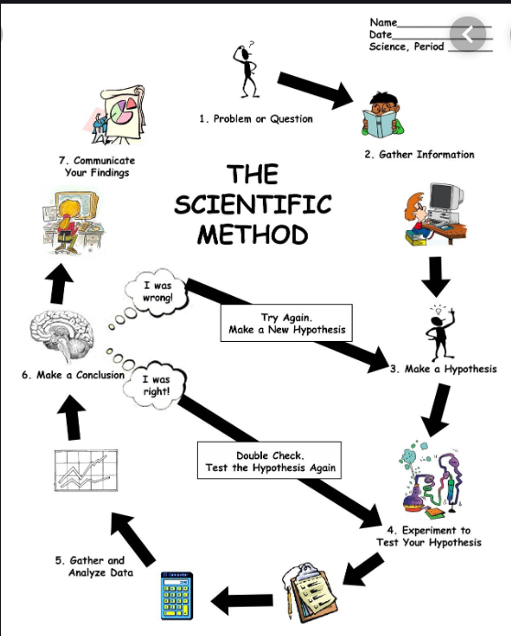
Methodology

Slide 5
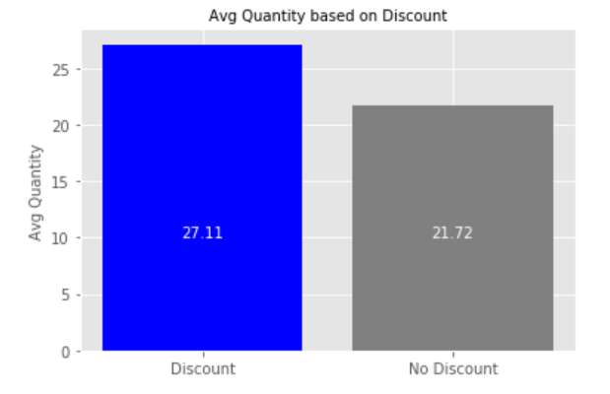
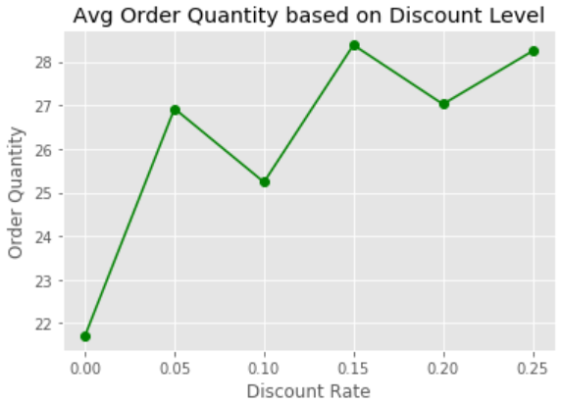
Analysis: Discount on Products
Discounts lead to higher sales quantities
All levels of discount are effective
Notes:
Hypothesis Test 1: Does discount amount have a statistically significant effect on the quantity of a product in an order?
- If so, at what level(s) of discount?
(Yes, Could not determine levels was not statistically significant)
We can conclude statistically that there is a statistically significant difference in the quantity ordered of discounted vs. non-discounted products. In another words, discount have a significant impact on quantity purchased (low p-value), regardless of the size of the discount (effect size).

Slide 6
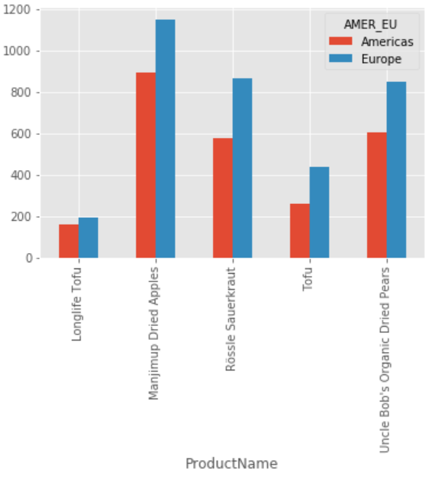
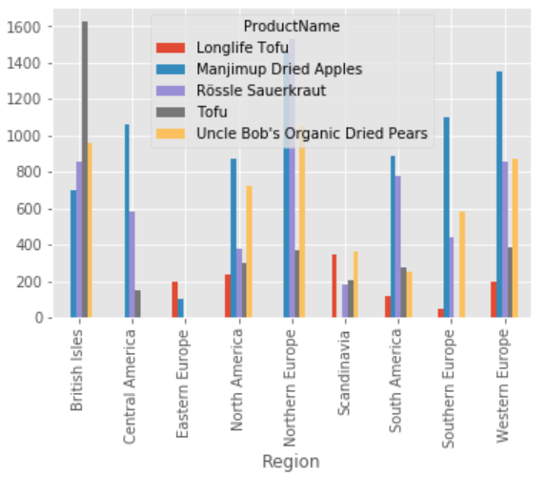
Analysis: Customer Buying Behavior – Produce (based on Sales)
Difference in buying behavior between the Americas and Europe
Increased demand for Tofu in Europe, esp. British Isle
Notes:
Hypothesis Test 2: Is there a significant difference in buying behavior on Produce between the Americas and Europe?
(Yes, Tofu is purchased more in Europe, esp. British Isle than Americas)

Slide 7
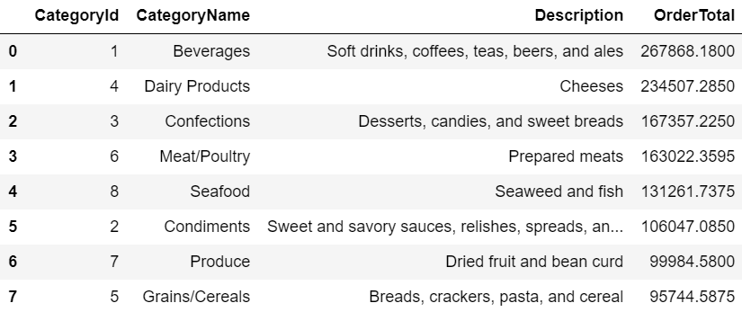
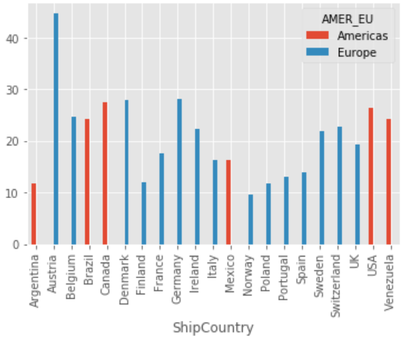
Analysis: Customer Buying Behavior – Beverages (based on Sales)
Beverages are the highest selling product line
Increased demand for beverages in Europe, esp. Austria
Austria sells the highest quantity of beverages
Notes:
Hypothesis Test 5: Is there a significant difference between the beverages sold in Europe and Americas?
(No, however, further analysis suggest that Austria beverages quantities are low as compared to other regions)
The alternative hypothesis is that there is significant difference between the beverages sold in Europe and Americas, esp. in Austria where the quantity of beverages sold is the highest of all countries.

Slide 8

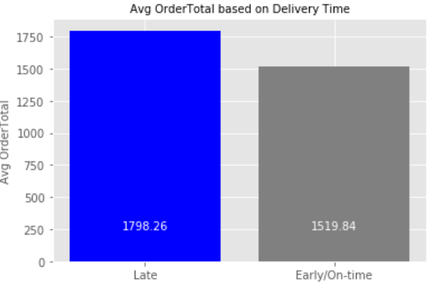
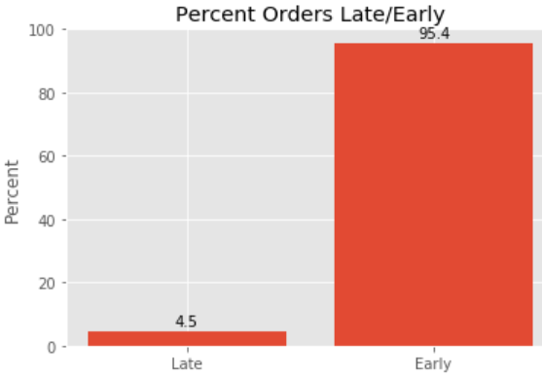
Analysis: Late Deliveries - (based on Order Sales)
Avg Order total for Late deliveries is 15.48% more than Early/On-Time
Late deliveries are not impacting Customer Sales
Late deliveries occur 4.5% of the time
Notes:
Hypothesis Test 3: Are late deliveries impacting Customer Sales?
(No) - Statistical analysis suggest that there is no difference in the ordering behavior of late and early shipments.
The mean order value for Customers who have had orders arrive late is higher than for those that that have not this is counter intuitive at first glance but could be indicative of other factors. For instance, larger order may be more difficult to collect and prepare for delivery on time, larger orders may require different transport methods that may be slower by necessity or customers that have had late orders may be inclined to order less frequently but in larger quantities.
Initial analysis on top late products suggest issue in delivering, Catg (4) - Grains/Cereals Breads, crackers, pasta, and cereal and Catg (1) Beverages Soft drinks, coffees, teas, beers, and ales.

Slide 9
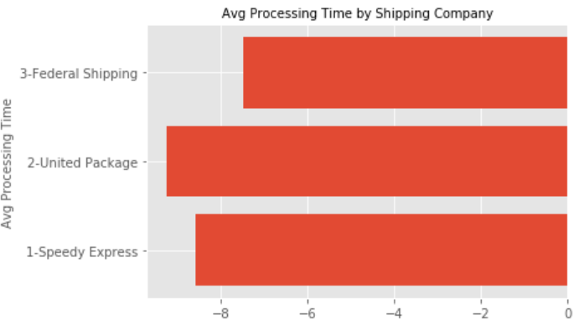

Analysis: Shipping Company Performance - (based on Processing Time)
Shipping companies' performance is shown in Processing Times:
Federal Shipping has the fastest processing time
United Package has the slowest processing time
-7.473896
--9.234921
-8.571429
Notes:
Hypothesis Test 4: Is there a statistically significant difference in performance of shipping companies?
(Yes, Processing time between X AND Y)
1- ProcTime: -8.571429
2- ProcTime: -9.234921
3- ProcTime: -7.473896

Slide 10

Findings/Recommendations
Customer Behavior
Increased demand for tofu in Europe, esp. British Isle
Increased demand for beverages in Europe, esp. Austria
Recommendation: Areas to consider price adjustments to increase revenue
Product Discounts
Discounts lead to higher sales quantities
Recommendation: Continue offering discounts on selected products
Shipping Company Performance
Late deliveries are not impacting Customer Sales
Difference in processing time between shipping companies
Recommendation: Address “slow” processing time with United Package

Slide 11

Future Work
Customer Behavior
Gain more insights as to why Europe is out selling the Americas, esp. in Produce and Beverage categories
Product Discounts
Gain more insights into what items to discount and at what level of discount to maximize sales
Shipping Company Performance
Partner with United Package to gain a better understanding of how orders are processed

Slide 12
Thank you !
Learn-co.slack.com
@Sharonda W

